Slide 1
The impact of inflation on US Economic Sectors
Project 3: Ella Ndalla

Slide 2
Proposal
Goal: The US economy is comprised of 11 sectors. The purpose of this analysis is to understand how a change in inflation impacts each sector’s performance.
Data: Leveraged Yahoo Finance API to fetch historical data of NYSE traded stocks under each sector covering the period ( 1/1/2014 to 7/31/2023). Leveraged Bureau of Labor Statistics to obtain Consumer Price Index (CPI) data ,as a measure of inflation, covering the same period.
Measures of performance: Calculated compound annual growth rate (CAGR) for CPI and each stock price and stock traded volume under each sector.
Visualization: Created a dashboard to compare each sector’s performance against the CPI.

Slide 3
Definitions
Energy Sector: Comprises companies engaged in exploration & production, refining & marketing, and storage & transportation of oil & gas and coal & consumable fuels. It also includes companies that offer oil & gas equipment and services.
Basic Materials Sector: Includes companies that manufacture chemicals, construction materials, forest products, glass, paper and related packaging products, and metals, minerals and mining companies, including producers of steel.
Industrials Sector: Includes manufacturers and distributors of capital goods such as aerospace & defense, building products, electrical equipment and machinery and companies that offer construction & engineering services. It also includes providers of commercial & professional services including printing, environmental and facilities services, office services & supplies, security & alarm services, human resource & employment services, research & consulting services. It also includes companies that provide transportation services.

Slide 4
Definitions Cont’d
Consumer Discretionary Sector: Encompasses those businesses that tend to be the most sensitive to economic cycles. Its manufacturing segment includes automobiles & components, household durable goods, leisure products and textiles & apparel. The services segment includes hotels, restaurants, and other leisure facilities. It also includes distributors and retailers of consumer discretionary products.
Consumer Staples Sector: Comprises companies whose businesses are less sensitive to economic cycles. It includes manufacturers and distributors of food, beverages and tobacco and producers of non-durable household goods and personal products. It also includes distributors and retailers of consumer staples products including food & drug retailing companies.",
Health Care Sector: Includes health care providers & services, companies that manufacture and distribute health care equipment & supplies, and health care technology companies. It also includes companies involved in the research, development, production and marketing of pharmaceuticals and biotechnology products.

Slide 5
Definitions Cont’d
Finance Sector: Contains companies engaged in banking, financial services, consumer finance, capital markets and insurance activities. It also includes Financial Exchanges & Data and Mortgage REITs.
Technology Sector: Comprises companies that offer software and information technology services, manufacturers and distributors of technology hardware & equipment such as communications equipment, cellular phones, computers & peripherals, electronic equipment and related instruments, and semiconductors and related equipment & materials.
Telecommunications Sector: Comprises companies that make communication possible on a global scale, whether through the phone, the internet, over airwaves, or cables. These companies create the infrastructure that allows data as text, voice, audio, or video to be sent anywhere in the world.

Slide 6
Definitions Cont’d
Utilities Sector: Comprises utility companies such as electric, gas and water utilities. It also includes independent power producers & energy traders and companies that engage in generation and distribution of electricity using renewable sources.
Real Estate Sector: Contains companies engaged in real estate development and operation. It also includes companies offering real estate related services and Equity Real Estate Investment Trusts (REITs).
Consumer Price Index (CPI): consists of a family of indexes that measure price change experienced by urban consumers. Specifically, the CPI measures the average change in price over time of a market basket of consumer goods and services

Slide 7
Dashboard Technicality
Front end (UI):
Consists of a main HTML page styled with bootstrap CSS stylesheet
Contains UI components, HTML structure,
Contains charts functionalities created using JavaScript D3.js and Plotly.js libraries
Dashboard setup (Backend):
Built using Python Flask Framework using a central python script App2.py
Hosted on the following : http://127.0.0.1:5000/
Database implementation(Backend):
Data stored on SQLite server using SQLAlchemy

Slide 8
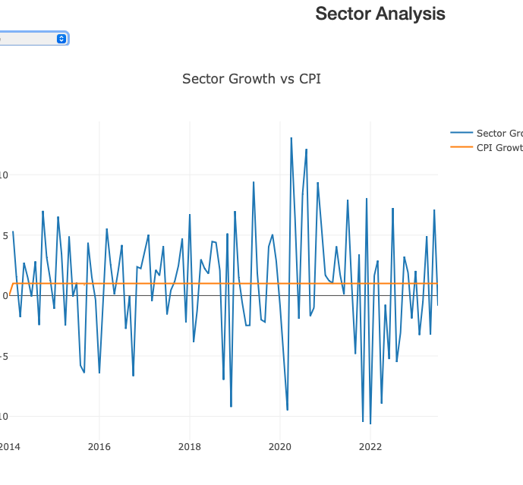
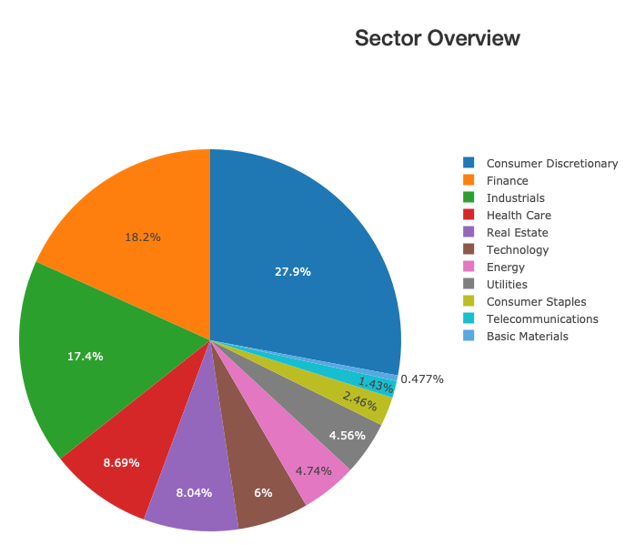
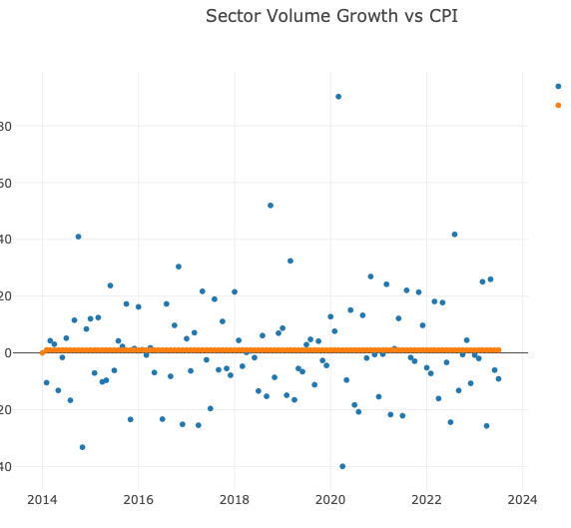
Does inflation impact US economic Sector performance ?
Let’s review the dashboard: http://127.0.0.1:5000/

Slide 9
Conclusion
Inflation in the past 10 years has been constant with an average growth of less than .5%
Major swings observed on several sectors (i.e. consumer staples) mainly during the COVID-19 pandemic
Inverse relationship is also noted between CAGR growth rate on Stock prices and Stock volume for US top 3 sectors(i.e. Finance, Industrials, Consumer Staples)
Conclusion: Inflation did not impact the performance of US sectors the past 10 years.

